Slide 1


Category Strategy
Q2 2025
B2B & Business Decision Makers Toolkit 25/26

Slide 2

What’s
Included
How
To Use
Based on customer & internal input, a new self-service toolkit covering the latest insights, strategies, & takeaways for all B2B brands (Big Tech, Mid-Tier, SMB) to drive impact with NBCU, including:
Category Macro Trends
B2B Audiences @ NBCU
Power of Endemic + Non-Endemic
Links to Relevant GTM Materials
Case Studies
Select/combine slides most relevant for client & agency discussions
Please note red boxes for any slide instructions
For client recommendations or customizations, contact Domnique Folacci & Nicole Lee (Category Strategy )
For GTM questions, contact Jess Cohen (Sales Enablement), Jenn Gettlin (News, Peacock, Ent), or Bonnie Fallon (Sports, Olympics)
2

Slide 3

NBCU’s B2B Toolkit
Click for section
Category Trends & Insights
Strategic
Audiences
Informed & Entertained Framework
Power of Premium
Live & Sports
Streaming
Opportunities
Endemic Programming
Branded Storytelling & Custom Content
Case Studies &
Benchmarks

Slide 4

B2B Category Trends & Insights

Slide 5
NBCU Spend
Consult Category Strategy for any required timely updates
While tariffs could impact finances & operations, some B2B brands may experience steady or increased demand for services
Reduced financial activity could reduce U.S. GDP by 1%
from curbed lending, investment, & overall financial activity¹
Rising CAPEX could heavily impact B2B growth & spend
AI costs will jump 5% above Big Tech’s already planned $325B in 2025, potentially diminishing innovation, revenue, and other budgets (e.g. advertising)²
Small businesses may reduce B2B services or B2B ad spend
thanks to rising costs, slowed business, and decreased VC funding & federal support³
Stickier B2B subcategories may be insulated or benefit
including software, consulting services, data analytics, & telco⁴
Source: 1) JPMorgan, 2) Yahoo Finance, 3) Business Insider, New York Times, 4) Fierce Network, NASDAQ, Business Insider

Slide 6
The ‘Business of Business’ continues to grow
40M
+19.4%
U.S. Business Decision Makers
SaaS global revenue CAGR
to reach $793B by 2029
resulting in a
more competitive
& crowded marketplace
+62%
+80%
B2B brands considered in
buying journeys
2024 vs. 2021
B2B sales to be generated digitally
by the end of 2025
vs. 13% in 2019
Source: 1. US Census & US Small Business Administration 2. Dentsu B2B Superpowers Index 2024 3. Gartner

Slide 7
And today’s decision-making process has grown more complex necessitating new sales & marketing strategies
Democratized Decision-Making
10-11
Average size of a business
decision-making group
72%
of buying teams hire outside consultants to influence decisions
Shrinking Shortlists
49%
of BDMs only consider 1-3 products per decision making cycle (up 16ppts YoY)
80-90%
of BDMs already have a vendor shortlist before the research process
Growing Prioritization
of Brand Building
95%
of BDMs are not in market now, but will be in the future while only 5% are projected to be in market now
45%
of B2B marketers would commit over half of marketing spend on brand if not for budget constraints
Source: 6Sense, G2, Corporatevisions, iSpot.tv, Mintel, NBCU Proprietary Research (BDMs), LinkedIn B2B Institute, eMarketer 2025

Slide 8
This Changing Landscape
Creates Distinct Challenges For Marketers
These challenges are not necessarily new, but are more important than ever to address
Finding the
Balance Between
Brand & Performance Strategies
Determining the right “Business Decision
Maker” Targets
Navigating Complex Decision Journeys To
Build Customer
Lifetime Value

Slide 9

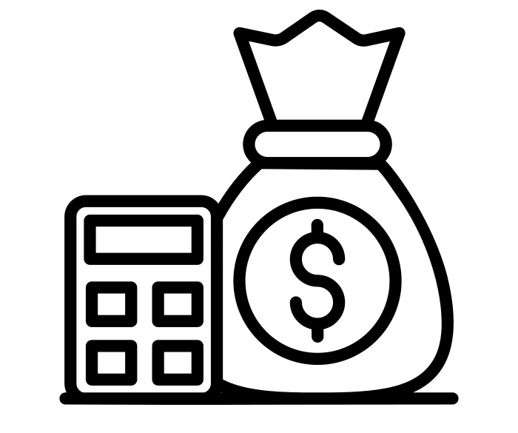


Determining the right “Business Decision Maker” targets
Decision-Making Stakeholder Matrix
Illustrative Example
In this changing landscape, decision-making stakeholders are moving targets consisting of different types of employees coming together in a matrix
Gatekeepers
Procurement
Influencers
Product
Users
10-11
Stakeholders involved in
the decision-making process
Final Decision Maker
IT
Legal
Notes:
We often see or hear the title “business decision makers” and think of CEOs, CMOs, CFOs, etc. but business decision makers no longer consist of just your traditional C-suite execs. Today, this ever-changing group of stakeholders can include many types of employees, coming together to make key decisions.
Because of this, it is important for marketers to factor that what was traditionally a singular perceived target is now more of a matrix and create tailored solutions accordingly.

Slide 10

Today’s business leaders are younger and more diverse –
B2B storytelling must evolve accordingly to authentically speak to them
Diverse
Avid Sports Fan
Female
+50% increase in multicultural business owners
(over last 10 years)
41% of Business Leaders are Female
Millennial
Reality TV Fan
71% of Business Leaders are under the age of 44
Gamer
48% of Business Leaders watch Sports on TV
52% of Business Leaders watch Reality TV
36% of Business Leaders enjoy gaming
Source: Global Web Index

Slide 11
Navigating complex decision journeys to build customer lifetime value
Growth Strategy Timeline:
61%
2010-2021
Growth driven by customer acquisition
of marketers report that the “growth at all costs” mentality is over
Today’s economic landscape can’t accommodate the high customer acquisition costs with the minimal returns that have defined the last decade of marketing strategy, sparking a shift to prioritizing lifetime value
67%
2022+
Growth driven
by tangible lifetime value
of businesses are prioritizing keeping current customers happy over acquiring new ones
Notes:
In the recent past, B2B marketers reported that growth was primarily driven by customer acquisition. In today’s world, this has changed and the “growth at all costs” mentality is no longer sustainable. Today’s economic landscape can’t accommodate the high customer acquisition costs with the minimal returns that have defined the last decade of marketing strategy. This has sparked a shift towards prioritizing tangible lifetime value – keeping current customers happy over acquiring new ones.

Slide 12
B2B marketers
must strike the right balance between
brand & performance strategies to
drive full funnel impact
Brand Building Opportunity
95%
of BDMs are not
in market now, but
will be in the future
Performance Opportunity
Only 5%
of decision makers are projected to be in-market to buy at
a given point in time
Source: iSpot.tv, Mintel, NBCU Proprietary Research (BDMs), LinkedIn B2B Institute
Notes:
You as B2B marketers don’t have it easy. We did a study with LinkedIn’s B2B Institute, and we found, the vast majority of BDMs are not currently in the market but will be in the future. That means you need to be top of mind from a BRAND perspective basically all the time but also be able to react to that 5% that are READY to buy now.
It’s important to strike the right balance between brand and performance strategies in order to succeed in today’s super competitive B2B & tech landscape

Slide 13





B2B marketers need effective media strategies to reach & influence
decision power
Notes:
With all that is changing, certain things remain true - B2B Marketers need effective ways to reach and influence the people making the decisions about their products & services – The people who will actually move the needle for their business.
AND NBCU DELIVERS THAT DECISION POWER.

Slide 14
Strategic B2B Audiences @ NBCU

Slide 15
286M
HHs per month
NBCUniversal continues to
be the right
partner to reach decision makers
Consult Audience Insights tool or I&M for latest B2B audience segments
Each month, our content reaches
44.7M
Business Decision Maker
Director Level & Above
38.6M
Technology Decision Makers
P2+
44.9M
Small Business Owners
that includes the
audiences that
matter to you
2.5M
C-Suite
15
Notes:
Source: Based on NBCU’s in-house audience insights using 1P and 3P data; date range: 2Q24; base: HH

Slide 16







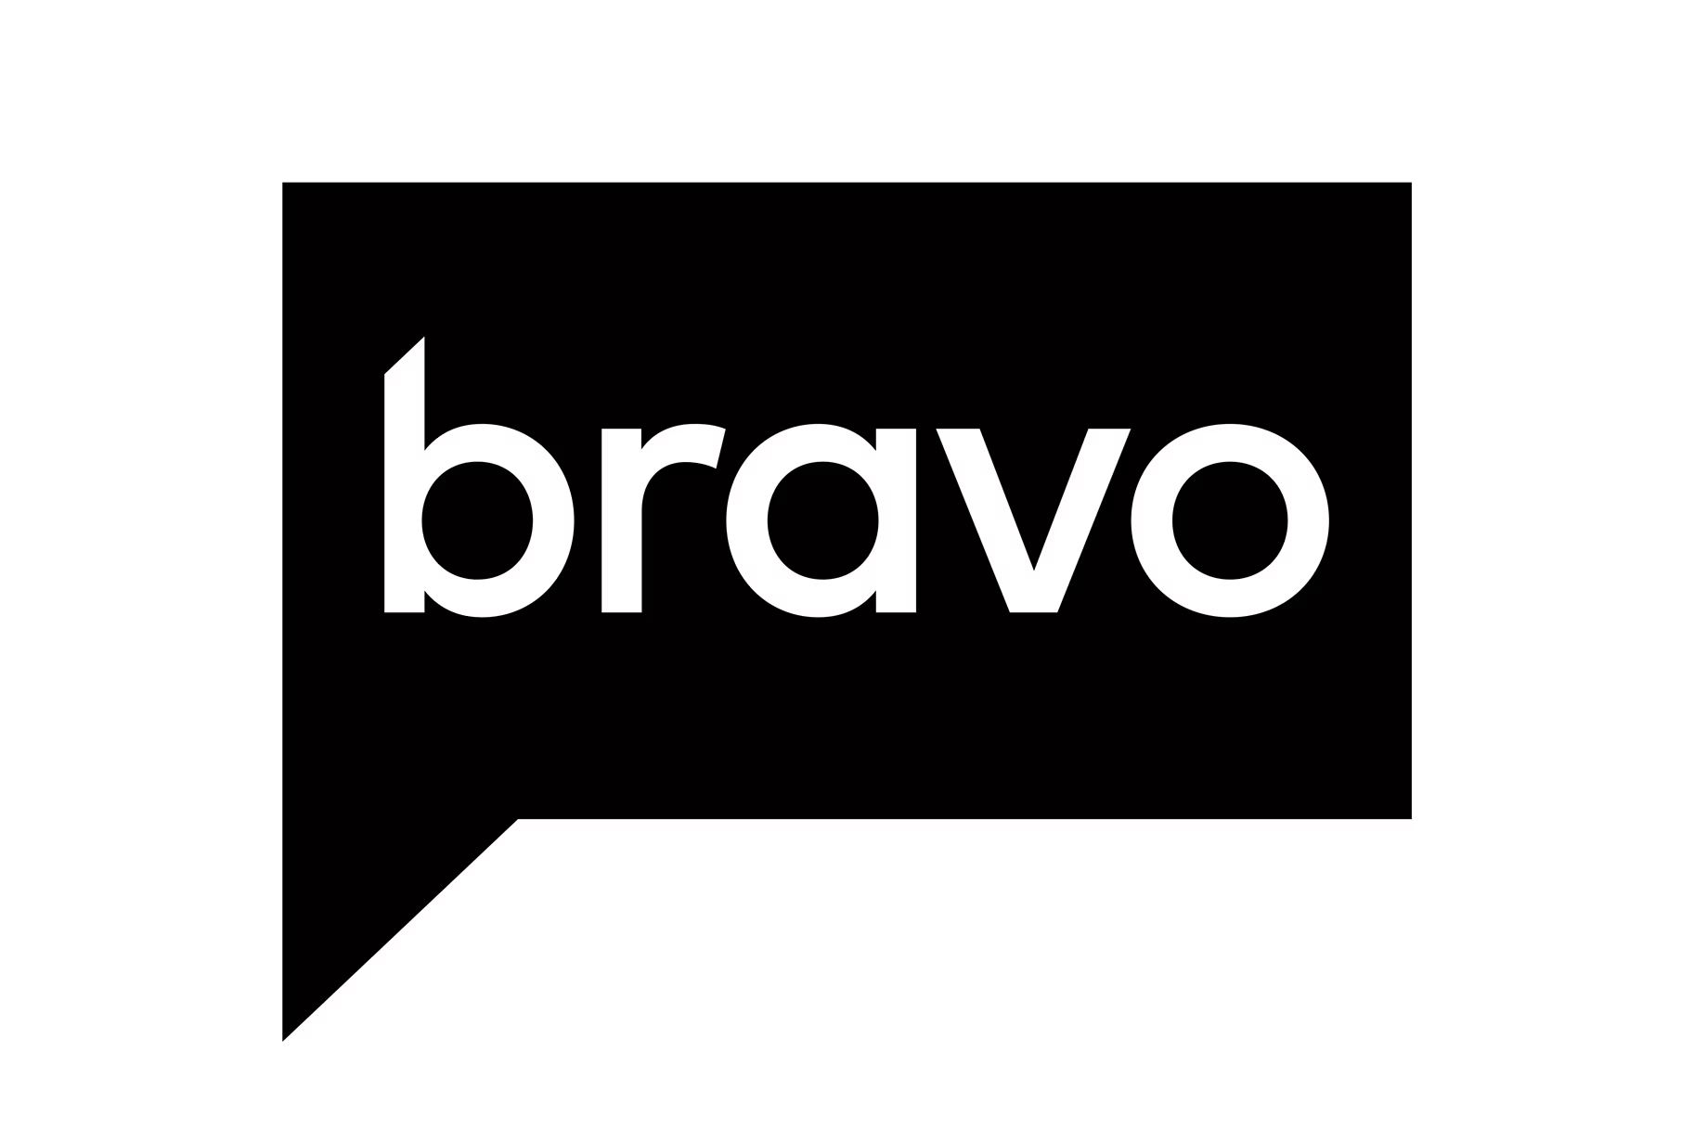



















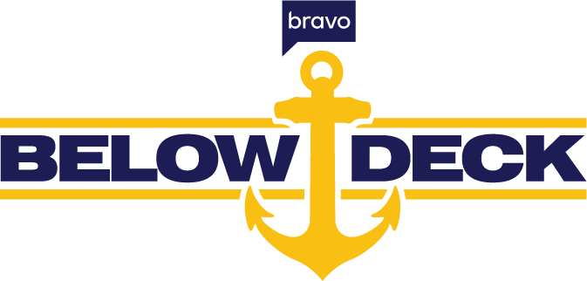


Consult Audience Insights tool or I&M for other B2B audience segments
This data-driven approach allows them to find nuanced audiences wherever & whatever they are watching
Business Decision Makers
Small Business Owners
C-Suite Executives
Sales & Marketers
What Are They Watching?
16
Notes:
Source: Based on NBCU’s in-house audience insights using 1P and 3P data; pulled as of 3.14.25, 12 month lookback, base P18+, HMID, based on index of target audience vs. baseline. *Note: Linear data is based on Vizio data at present time and not projected out to the larger NBCU Population--use for directional purposes only. Digital brands based on reach across display and video, base P18+, HMID.

Slide 17
Tech & Finance B2B primarily leverage B2B audience segments
to reach decision-makers where they’re most engaged across NBCU’s portfolio
'24 NBCU Share of Advertisers* by
Audience Segment Category
Key Demo Segments
Behavior
e.g., Shopping, Tech Habits
Demo - Income
Adults 25-54
Adults 18+
HHI 75K or Greater
Adults 18-34
Media
e.g., Golf Channel,
NBC Sports
B2B
e.g., BDMs,
C-Suite
Interest
e.g., Sports,
Finance
78%
Non-Demo Audiences
Key Non-Demo Segments
Custom
e.g., bespoke audiences, client 1P data
Business Decision Makers
C-Suite Executives
BDMs OR C-Suite
Institutional Investor
Finance
e.g., High Net
Worth Investor
Demo – Age &
Gender
Chief Executive Officer CEO
Trader
Top Telco B2B Segments: 1) Business Decision Makers, 2) Business Decision Makers OR C Suite,
3) IT Decision Makers, 4)Small Business Owners
Source: NBCU AIO & PG Segments. Based on distinct count. Excludes Telco. Share does not account for duplication. Advertisers can be included in more than one category.

Slide 18








Consult I&M for other B2B audience cuts (ex. BDMs Spending $100K or $1M+, Consulting Services BDMs, Travel BDMs, etc.)
BDMS Spending
$10K+ Annually
C-Suite
Small Business Owners
NBCU reaches more
high value business targets
monthly than traditional
B2B powerhouses
Source: 2025 MRI Custom Video Study. U.S. P18+ population. Cross Platform
Notes:
We wanted to look at how Comcast/NBCU stacks up against some of the outlets perceived as traditional B2B powerhouses – ‘Apples to Apples.’ Using the GFK Custom Cable Study, which looks at total cross-platform brand footprints, and keeping that $10K+ Quality BDM qualifier, we see that the properties of Comcast/NBCU far outpace the reach of traditional B2B partners like the New York Times and the Wall Street Journal. While that may not come as a surprise considering our Platform’s massive reach, as we layer in higher levels of spend – $100K, $500K, $1M and up to the highest levels of the C-Suite, NBCU’s advantage only grows.
Also of importance here, and making NBCU stand out from other Media Conglomerates as well as the Facebooks and Googles of the world, we have one of those traditional B2B facing brands in CNBC, which holds its own – on its own – within this competitive set.
Another brand in our portfolio – Golf Channel – has a powerful individual reach story as well.
Combining CNBC + Golf together, we reach 29% of those quality $10K+ BDM’s, greater than the New York Times in total cross platform reach against those traditional B2B powerhouses.
When you add this all up…

Slide 19
Consult I&M for other B2B audience cuts (ex. BDMs Spending $100K or $1M+, Consulting Services BDMs, Travel BDMs, etc.)
BDMS Spending
$10K+ Annually
C-Suite
Small Business Owners
NBCU reaches more
high value business targets
monthly than traditional
B2B powerhouses
Source: 2025 MRI Custom Video Study. U.S. P18+ population. Cross Platform. C-Suite = C-suite 1 or C-suite 2
Notes:
We wanted to look at how Comcast/NBCU stacks up against some of the traditional B2B powerhouses – ‘Apples to Apples.’ Using the GFK Custom Cable Study, which looks at total cross-platform brand footprints, and keeping that $10K+ Quality BDM qualifier, we see that the properties of Comcast/NBCU far outpace the reach of traditional B2B partners like the New York Times and the Wall Street Journal. While that may not come as a surprise considering our Platform’s massive reach, as we layer in higher levels of spend – $100, $500K, $1M and up to the highest levels of the C-Suite, NBCU’s advantage only grows.
Also of importance here, and making NBCU stand out from other Media Conglomerates as well as the Facebooks and Googles of the world, we have one of those traditional B2B facing brands in CNBC, which holds its own – on its own – within this competitive set.
Combining CNBC + Golf together, we reach 32% of those quality C-Suite, greater than the New York Times in total cross platform reach against those traditional B2B powerhouses.

Slide 20
Consult I&M for other B2B audience cuts (ex. BDMs Spending $100K or $1M+, Consulting Services BDMs, Travel BDMs, etc.)
BDMS Spending
$10K+ Annually
C-Suite
Small Business Owners
NBCU reaches more
high value business targets
monthly than traditional
B2B powerhouses
Source: 2025 MRI Custom Video Study. U.S. P18+ population. Cross Platform. Small Business Owners = 0-50 employees
Notes:
We wanted to look at how Comcast/NBCU stacks up against some of the traditional B2B powerhouses – ‘Apples to Apples.’ Using the GFK Custom Cable Study, which looks at total cross-platform brand footprints, and keeping that $10K+ Quality BDM qualifier, we see that the properties of Comcast/NBCU far outpace the reach of traditional B2B partners like the New York Times and the Wall Street Journal. While that may not come as a surprise considering our Platform’s massive reach, as we layer in higher levels of spend – $100, $500K, $1M and up to the highest levels of the C-Suite, NBCU’s advantage only grows.
Also of importance here, and making NBCU stand out from other Media Conglomerates as well as the Facebooks and Googles of the world, we have one of those traditional B2B facing brands in CNBC, which holds its own – on its own – within this competitive set.
Combining CNBC + Golf together, we reach 24% of those quality SBOs and greater than the New York Times in total cross platform reach against those traditional B2B powerhouses.

Slide 21

A data-driven, audience strategy maximizes reach & impact for B2B brands

Slide 22
Activate your audiences your way with flexible, always-on options to meet your objectives
Streaming
Dynamic, 1:1 addressable delivery
across CTV, desktop, and mobile
Direct IO,
PG, or PMP
Managed service
or self-service
NBCU only
or cross-pub
with OpenAP
Data-driven
linear (DDL)
Enhanced 1:many delivery at scale through the broad reach of national linear TV
NBCU only
or cross-pub
with OpenAP
Streaming via direct IO or PG
Cross-platform
(XP)
One Platform Total Audience
Unified, cross-platform strategic audience optimization across linear & streaming

Slide 23
B2B brands leveraging a data-driven approach with NBCU have already found success
More Target Audience
Impressions
+36%
Higher Target Audience Index
+9%
Greater Target Audience Reach
+55%
Better Cost Efficiency
& Lower CPM
-20%
Source: AdSmart advanced audience campaign performance vs. standard demo campaign performance; B2B category average 2022-2023 YTD

Slide 24
NBCU Tech
B2B Spend
1H’25 v. 1H’24
Broadcast Entertainment
grew as a key vehicle for mass reach as brands activate messaging across Prime & Late Night
Cross-Platform Sports
investment grew as advertisers leverage the fan-favorite genre across CTV
Broadcast Entertainment spend grew 3x vs. STLY
Linear & streaming sports spend grew +7% vs. STLY, accounting for 34% of total spend
The subcategory is not only growing spend, but diversifying spend across platforms & genres to reach audiences wherever they’re consuming content across our CTV ecosystem
Programmatic Streaming
spend grew 2x as brands utilize flexible & efficient channels to reach CTV audiences
News
remains a resilient & effective channel for endemic & business news contextual marketing
News accounted for 20% of total spend, up 9pp vs. STLY
Programmatic share of total spend grew 6pp vs. STLY
Source: Internal NBCU Spend

Slide 25


believes in reaching your audience when they want to be:
Informed
&
Entertained

Slide 26



#1
Business Network for monthly cross-platform reach (2.4X higher than Bloomberg)
Business News site for Time Spent Watching Video (+54% vs. #2 Property)
60+
10k+
Events each year convening core business audiences Including
C-suite executives, business decision makers, financial advisors, investors, opinion leaders & more
Total Attendees Across CNBC Events & CNBC Council Events in 2023
Informed
59%
22x
50%
Increased brand recall with branded content vs. standard digital ads
Branded content is more engaging vs. display ads
Brand lift for branded content distributed through premium publishers
Notes:
Combining NBCU’s powerful reach, with real Engagement is the true winning formula.
NBCU is uniquely poised to engage Business Decision Makers on both a professional and personal level - at both Work and Play.
While they are thinking business and while they are enjoying their passions.

Slide 27
Connecting when BDMs are informed is integral,
but advertisers can further differentiate with emotion-driven content & entertainment
56%
88%
2x
of the business decision-maker choice comes down to emotional factors
of business leaders are more likely take note of advertising from B2B brands that speak to their passions and interests
B2B video ads that incorporate emotional content see 2x the web visitation vs those that only incorporate rational content
Source: NBCU Proprietary Global BDM Research; Hubspot, AdAge, Merkle

Slide 28
90%
of business leaders say a good B2B ad captures their attention if they’re relevant; it doesn’t matter if they run in business content
Select top programs amongst BDMs @ NBCU
Entertained

Slide 29
The Power of Premium
(Live + Sports)
Pull relevant slides from latest 25/26 GTM Deck

Slide 30

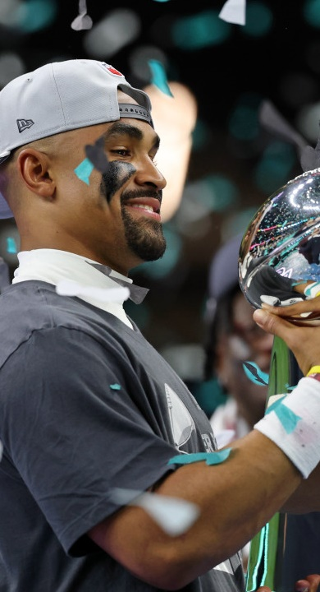





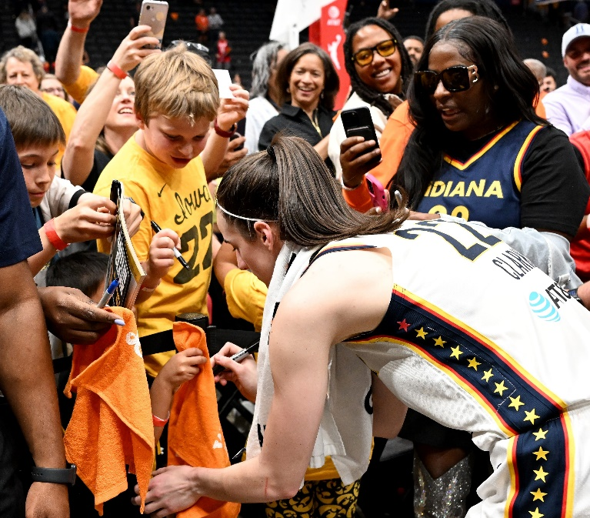
Pull relevant slides from latest
2025 Sports Upfront Deck
The Unique Value & Unstoppable Rise of Sports in Media
Notes:
In an era of fragmented media consumption, the continued rise of sports have made it the cornerstone of the entire ecosystem. Sports media remains one of the few experiences that can universally unify audiences and ultimately has an economic ripple effect on the entire industry.

Slide 31
The Power of Peacock /
NBCU Streaming
Pull relevant slides from latest 25/26 GTM Deck

Slide 32

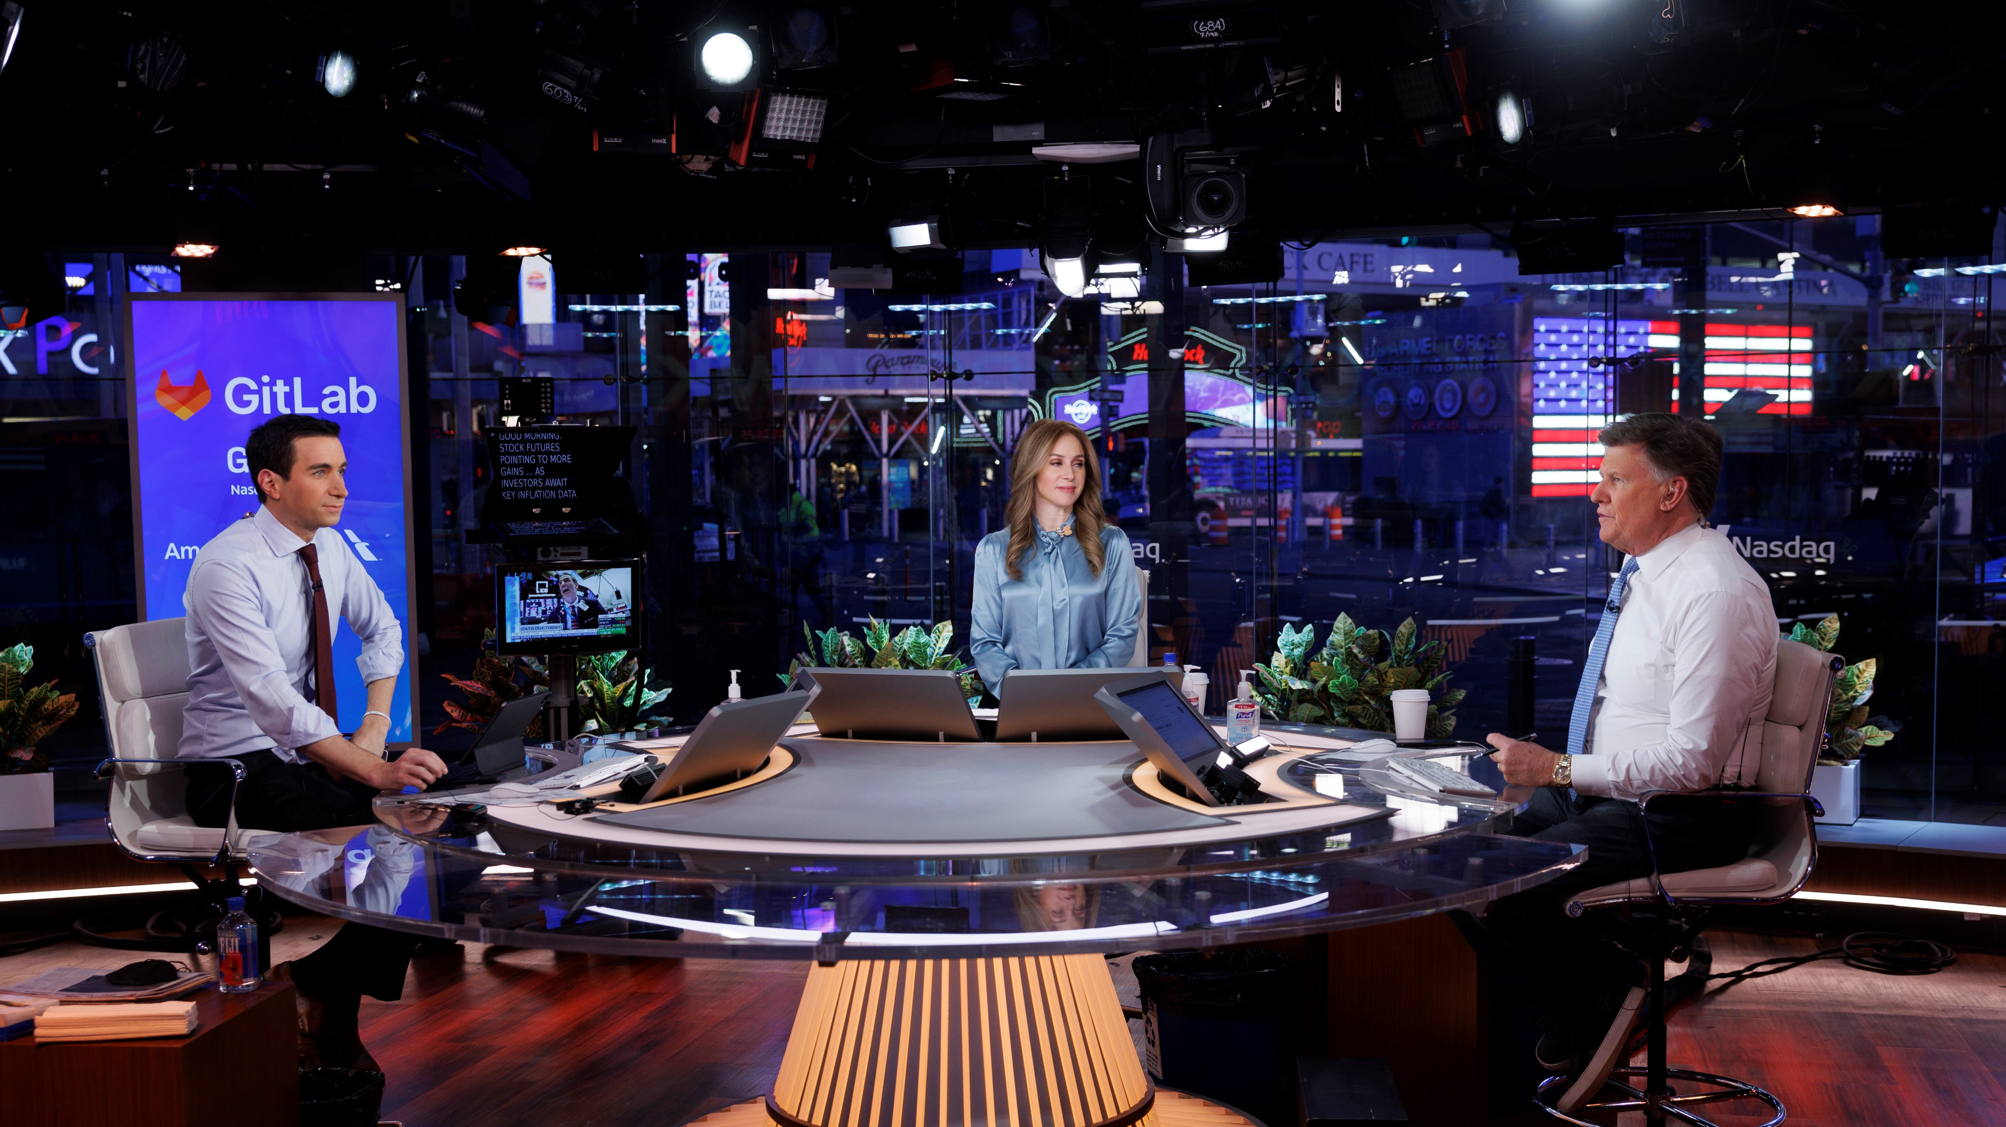
Pull relevant slides from latest CNBC GTM Deck
World Leader in Business News

Slide 33

Why News
Pull relevant slides from latest News GTM Deck
Why
News
2025

Slide 34

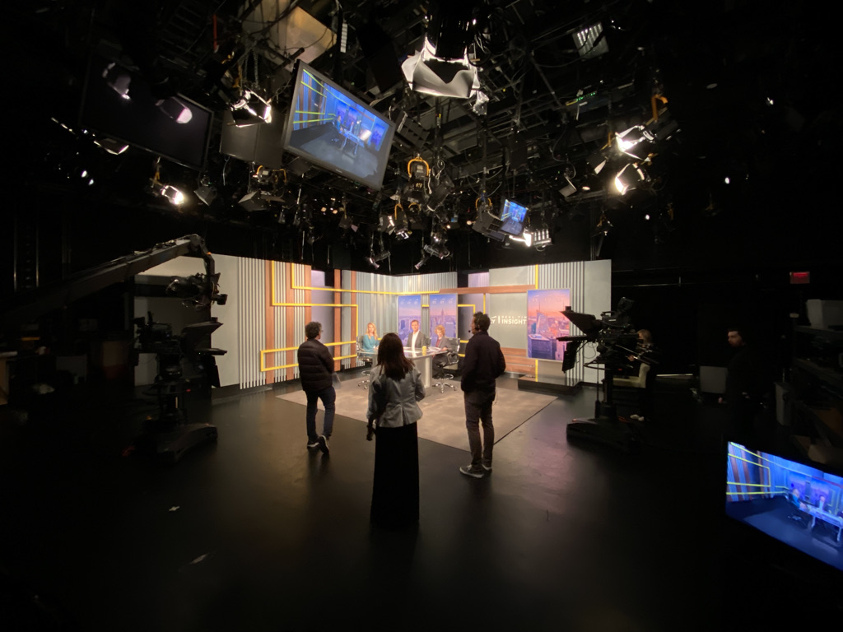

We Are A News Studio For Brands
Pull relevant slides from latest
News Brand Studio GTM
Why Branded Content?
Branded Content is a highly effective way for brands to deliver their messaging. Brand recall is 59% higher with branded content than with other digital ads and 22x more engaging than display ads. Further, branded content distributed through premium publishers has a 50% higher brand lift.*
The award-winning NBC News Brand Studio can engage your brand’s audience across the NBCU portfolio through strategic branded content that tells your brand’s story, lifting awareness, consideration and action.
*AdWeek, Pressboard, eMarketer

Slide 35
B2B Case Studies
& Benchmarks

Slide 36

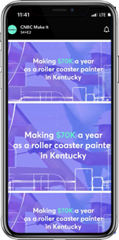
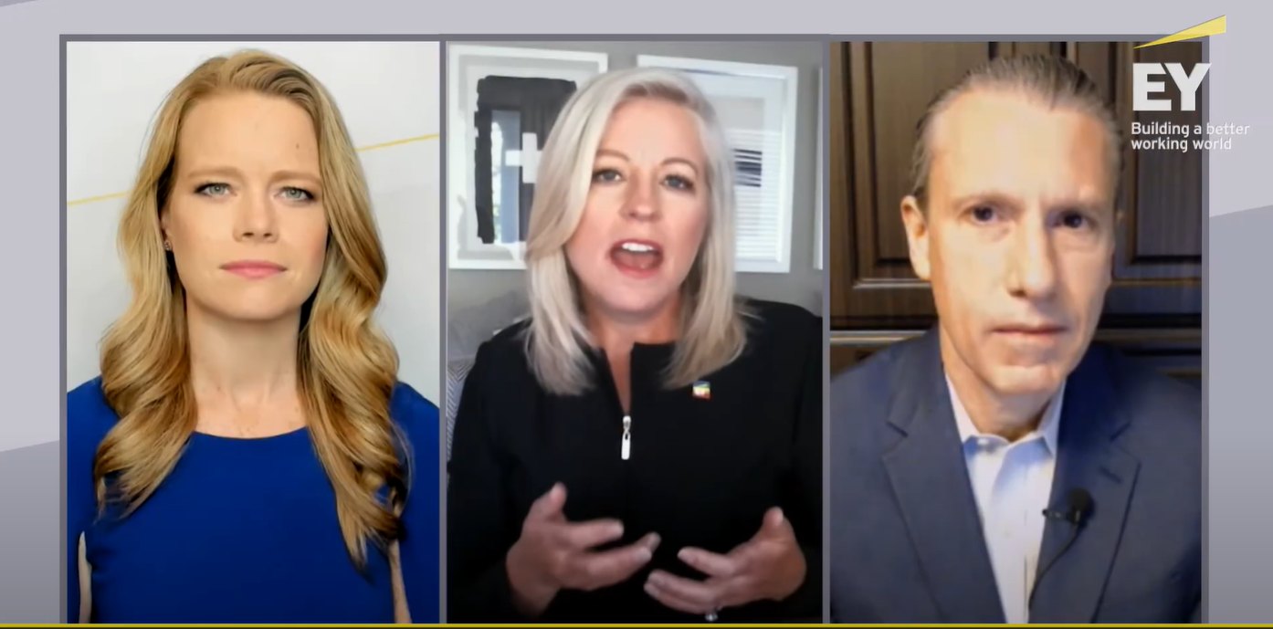
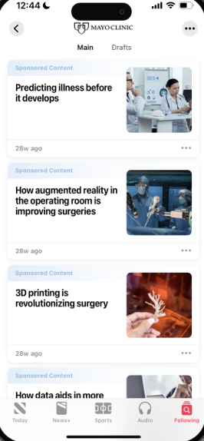
See themes/takeaway options to help select which case study is most relevant →
Impact of custom content
Leveraging endemic
Driving KPIs
(brand lift & credibility)
Solution
Recognizing the power of partnership, we leveraged CNBC Brand Studio to craft a custom content series featuring this brand’s leaders and strategic partners discussing forward looking trends
The brand partnership was further amplified via broader NBCU
digital/social portfolio
B2B Consulting Org Case Study
Customizing Campaigns via Trusted Programming
Please note images are for illustrative purposes only*
Results
Exposure Drove Brand Lift
CNBC Partnership Drove Affinity
+13%
Brand Opinion
92%
agree this brand is a good fit for CNBC
Challenge
Demonstrate brand thought leadership and engage target BDMs to amplify B2B reputation and affinity
+17%
Recommendation
Notes:
Client: EY

Slide 37
See themes/takeaway options to help select which case study is most relevant →
Power of endemic
& non-endemic
Reaching BDMs across portfolio
Driving KPIs & action
Solution
Optimization resulted in expanding number of linear properties purchased, while also increasing CNBC, and still including Golf
UNOPTIMIZED
OPTIMIZED
Number of Properties: 3
Number of Properties: 7
B2B IT Company Case Study
Optimizing Beyond Traditional Channels
Results: EDO Search Engagement
+32%
lift in search engagement compared to non-NBCU linear
+17%
lift in search engagement compared to NBCU non-DDL
Challenge
A leading IT company wanted to make the most of their linear ad spend to drive search engagement
Power of E!, Oxygen, Bravo
New non-endemic networks outperformed endemic networks and drove some of the strongest search engagement lifts
Notes:
Client: CDW

Slide 38





See themes/takeaway options to help select which case study is most relevant →
Power of diverse
media mix
Reaching BDMs across portfolio
Driving full funnel results
Solution
Identify impactful alignment points throughout a cross-genre campaign to maximize audience reach and execute a multi-layered, study including qualitative and quantitative research as well as bio-metric screening to measure the impact of the campaign.
B2B IT Company Case Study
EMMYS
Activating the Full Funnel
Results
Brand Awareness & Familiarity
Favorability Towards Brand
Brand Consideration
Challenge
A leading IT/Consulting company wanted to gain insights into audience viewing behavior and the impact of advertising across multiple types of content
79%
of BDMs
vs. 21% Not Aware
70%
of BDMs
vs. 6% Not Favorable
65%
of BDMs
vs. 10% Unlikely to Consider
Notes:
Client: Accenture

Slide 39
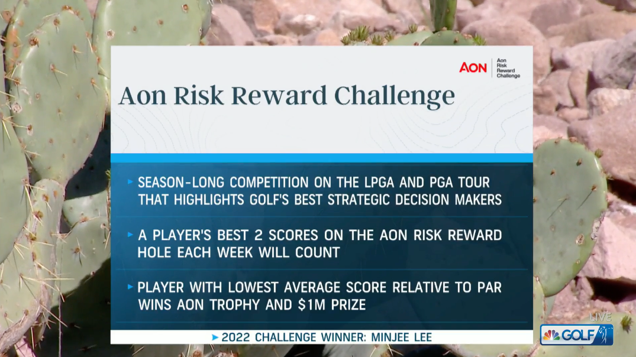
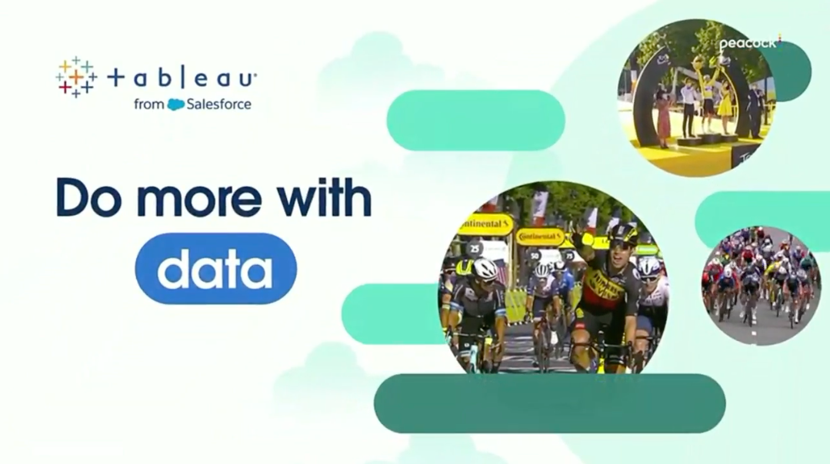
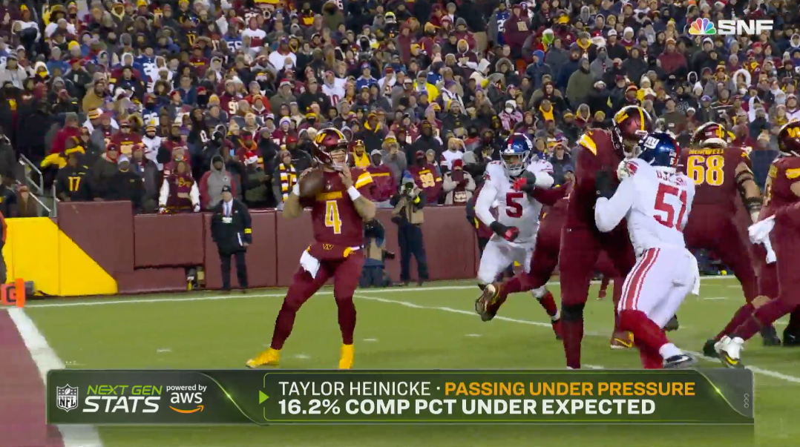
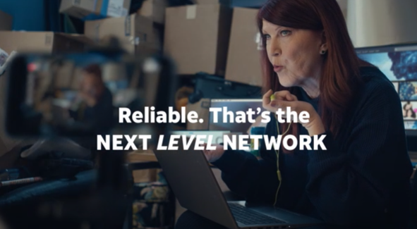
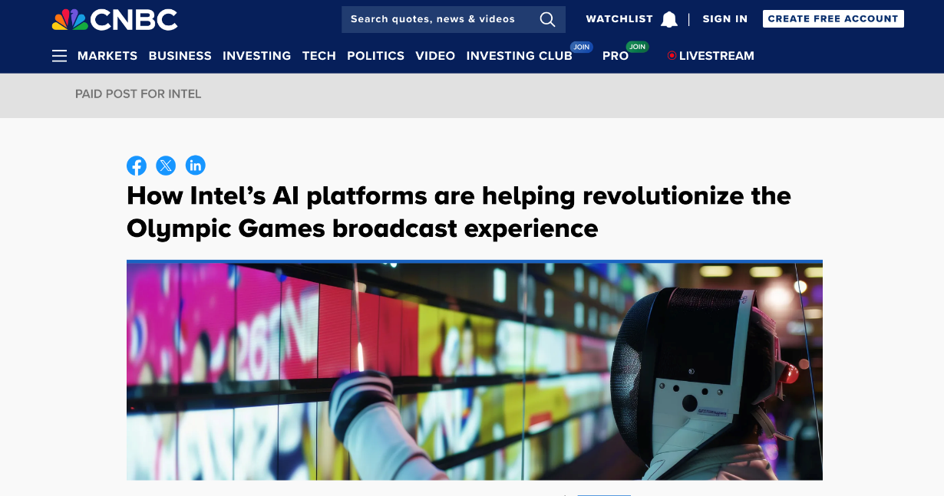
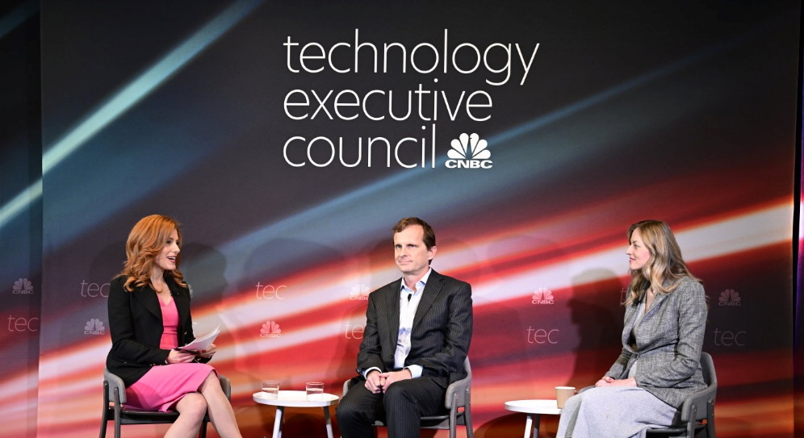
How B2B partners are evolving their storytelling
Establishing Season-Long Integrated Messaging
AON Risk Reward Challenge engaged viewers as an always-on campaign during PGA & LPGA Tours
Enhancing the Fan Experience
Salesforce’s Tableau created custom
analysis during Tour de France coverage
Demonstrating
Product Capabilities
AWS powered unique insights highlighted via SNF in-game features
Leveraging Fan-Favorite Talent
Customizing Content via Trusted Tentpoles & Platforms
Activating Experiential
for 1:1 Connection
Salesforce sponsored CNBC’s Technology Executive Council to engage a curated audience
AT&T Business’s “Executive Edge” CNBC campaign featured ”The Office” talent to employ humor & capture attention
Intel contextualized its tech to the Paris Olympics to enhance credibility

Slide 40
NBCUniversal is also the right partner to make an impact of decision makers
Tech B2B Benchmarks
NBCU Tech B2B Campaigns – Test vs. Control
Upper
Unaided Brand Recall
+13%
Brand
Familiarity
+12%
Aided Brand
Recall
+19%
Middle
Search
Engagement
+88%
Brand
Favorability
+5%
Consideration Intent
+11%
Lower
Purchase Intent
+10%
Recommendation Intent
+14%
Source: NBCU Ad Impact Database 2017-2023, 38 Campaigns across 7 Brands NBCU measured Insurance campaigns​
Custom research, vendors vary. Average of exposed vs. control cells for NBCU. Top 2 box
Search Engagement (SER Index): EDO, Volume in five minutes following ads airing on NBCU vs. same brand competitive averages expressed as an index (123).

Slide 41
NBCUniversal is also the right partner to make an impact of decision makers
Finance Benchmarks (B2B cut not avail)
NBCU Finance Campaigns – Test vs. Control
Upper
Aided Brand Recall
+13%
Unaided Brand Recall
+28%
Ad
Recall
+47%
Brand
Familiarity
+30%
Middle
Brand Favorability
+25%
Sponsorship
Favorability
+16%
Sponsorship Association
+63%
Message Association
+48%
Lower
Search
Engagement
+59%
Consideration
Intent
+55%
Purchase
Intent
+16%
Recommendation Intent
+43%
Source: NBCU Ad Impact Database 2017-2023, 172 Campaigns across 57 Brands NBCU measured Finance campaigns​
Custom research, vendors vary. Average of exposed vs. control cells for NBCU. Top 2 box
Search Engagement (SER Index): EDO, Volume in five minutes following ads airing on NBCU vs. same brand competitive averages expressed as an index (159).

Slide 42
NBCUniversal is also the right partner to make an impact of decision makers
Telco Benchmarks (B2B cut not avail)
NBCU Telco Campaigns – Test vs. Control
Upper
Unaided Ad Recall
+51%
Ad
Recall
+16%
Brand
Familiarity
+5%
Middle
Brand
Favorability
+11%
Sponsorship
Favorability
+11%
Sponsorship
Association
+10%
Lower
Search
Engagement
+44%
Purchase
Intent
+17%
Recommendation Intent
+27%
Consideration Intent
+25%
Any Web
Visit
+54%
Source: NBCU Ad Impact Database 2017-2023, 124 Campaigns across 19 Brands NBCU measured Telco campaigns​
Custom research, vendors vary. Average of exposed vs. control cells for NBCU. Top 2 box
Search Engagement (SER Index): EDO, Volume in five minutes following ads airing on NBCU vs. same brand competitive averages expressed as an index (144).

Slide 43
Campaigns across more than one platform are more effective
Tech Cross-Platform Benchmarks (B2B cut not avail)
Tech Category NBCU Campaigns:
Multi-Platform vs. Single Platform
% Lift
+47%
Ad
Recall
+48%
Brand
Favorability
+10%
Purchase
Intent
+49%
Recommendation
Intent
Source: NBCU Ad Impact Database 2017-2023, 76 Single Platform Campaigns v. 36 Mult-Platform Campaigns
Custom research, vendors vary. Average of test cells for 2+ platforms vs. single platform campaigns

Slide 44
Campaigns across more than one platform are more effective
Telco Cross-Platform Benchmarks (B2B cut not avail)
Telco Category NBCU Campaigns:
Multi-Platform vs. Single Platform
% Lift
+19%
Ad
Recall
+8%
Brand
Favorability
+22%
Recommendation
Intent
+13%
Consideration
Intent
+11%
Purchase
Intent
Source: NBCU Ad Impact Database 2017-2023, 69 Single Platform Campaigns v. 55 Mult-Platform Campaigns
Custom research, vendors vary. Average of test cells for 2+ platforms vs. single platform campaigns

Slide 45
Campaigns Across More than One Platform Are More Effective
Finance Cross-Platform Benchmarks (B2B cut not avail)
Finance Category NBCU Campaigns: Multi-Platform vs. Single Platform
% Lift
+6%
Unaided Brand
Recall
+6%
Purchase
Intent
+113%
Message
Association
+167%
Sponsorship
Association
Source: NBCU Ad Impact Database 2017-2023, 92 Single Platform Campaigns v. 80 Mult-Platform Campaigns
Custom research, vendors vary. Average of test cells for 2+ platforms vs. single platform campaigns

Slide 46
Tech (Peacock)
Proven impact across client KPIs
Tech Peacock Benchmarks (B2B cut not avail)
NBCU Tech Campaigns – Test vs. Control
Brand
Familiarity
+19%
Ad Recall
+4%
Message
Association
+18%
Purchase
Intent
+21%
Recommendation
Intent
+7%
Source: NBCU Ad Impact Database 2017-2023, 51 Campaigns across 34 Brands Peacock measured Tech campaigns ​
Custom research, vendors vary. Average of exposed vs. control cells for NBCU. Top 2 box

Slide 47
Finance Peacock Benchmarks (B2B cut not avail)
Finance (Peacock)
Proven Impact Across Client KPIs
NBCU Finance Campaigns – Test vs. Control
Upper
Unaided Ad
Recall
+37%
Unaided Brand Recall
+3%
Aided Ad
Recall
+10%
Brand
Familiarity
+2%
Middle
Brand Favorability
+13%
Sponsorship
Favorability
+8%
Sponsorship Association
+2%
Message Association
+1%
Lower
Consideration
Intent
+22%
Purchase
Intent
+2%
Recommendation Intent
+14%
Source: NBCU Ad Impact Database 2017-2023, 36 Campaigns across 12 Brands Peacock measured Finance campaigns ​
Custom research, vendors vary. Average of exposed vs. control cells for NBCU. Top 2 box

Slide 48


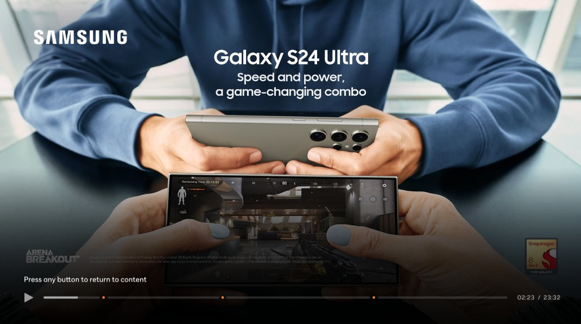
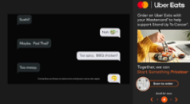

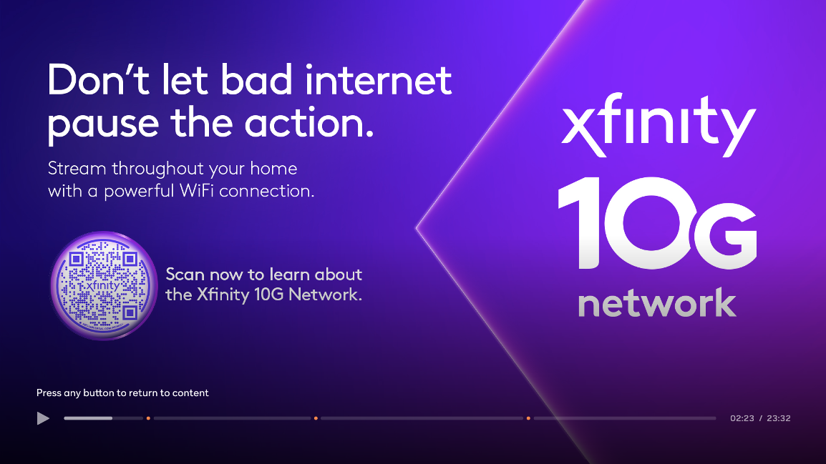

Spotlight Ad
Pod Bounce
Power of
Ad Innovations
Drive Effective Results through Strategic Application and Category Best Practice
+34%
+58%
Brand Memorability
vs Midroll for Category
Ad Likeability
vs. Midroll for Category
Finance
Power Break Ad
Engagement Ad
Tech
+65%
+11%
Ad Likeability
vs. Midroll for Category
Message Memorability
vs. Midroll for Category
Pause Ad
Audience Targeted Pause Ad
75%
Telco
of B2B brands that invested in Ad Innovations in 2023 increased investments in 2024
+33%
Ad Likeability
vs. Midroll for Category
+98%
Ad Likeability
vs. Midroll for Category
*Lifts are not guaranteed and are dependent on creative
Source: KPI Monthly Report and Ad Innovation Case Studies
Notes:
Tech
Spotlight: Own the first impression with a Spotlight Ad for major product launches or key category holidays (ex. Black Friday, Cyber Monday)
Pause: Celebrate new product releases or enhancements during a user’s break with Pause Ads and scannable CTAs to drive further engagement
Curator: Align your brand with content curated based on mood, genre, event or other theme to drive brand identity and love
Power Break: Supercharge your pause ad to promote new product releases or enhancements during a user’s break with an extra layer of targeting to reach specific audiences.
Finance
Pod Bounce: Leverage a Pod Bounce to offer additional “returns” for consumers
Engagement: Recruit new banking or investing customers & maximize accessibility by utilizing an interactive Engagement Ad
Telco
Audience Targeted Pause Ad: Supercharge your pause ad to promote new product releases or enhancements during a user’s break with an extra layer of targeting to reach specific audiences.

Slide 49
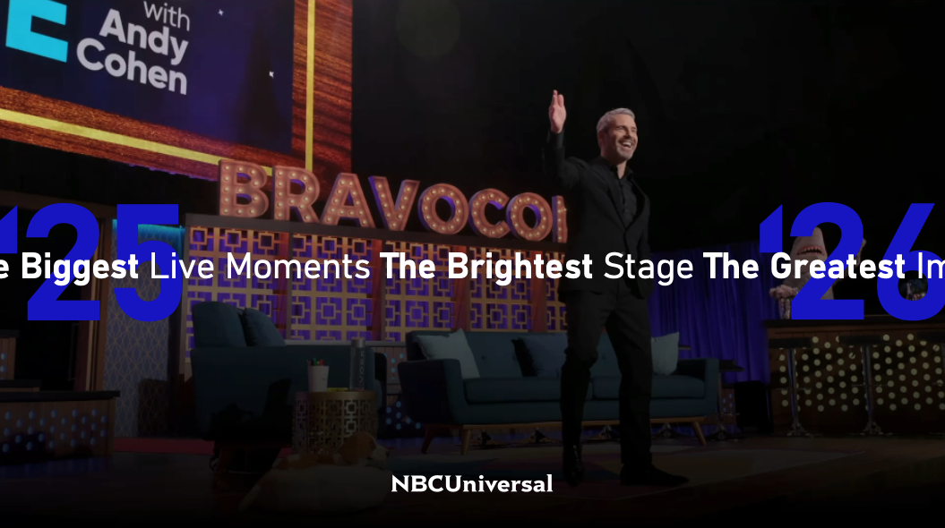
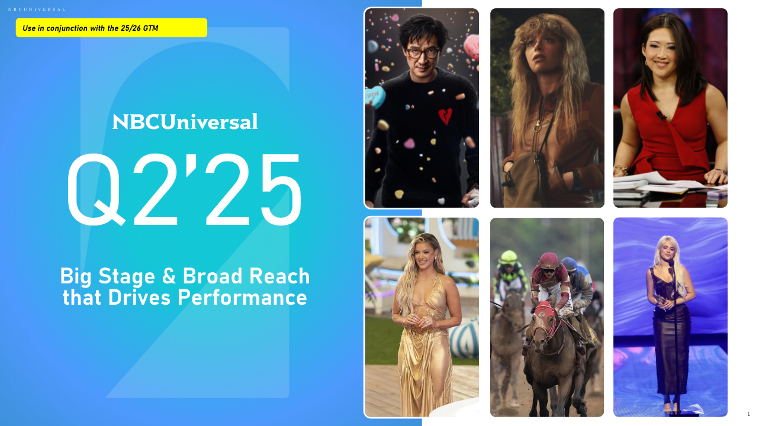
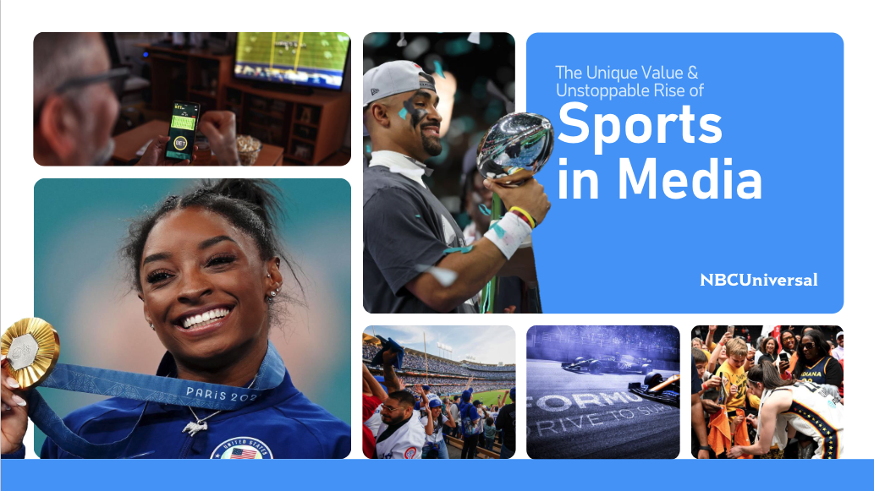
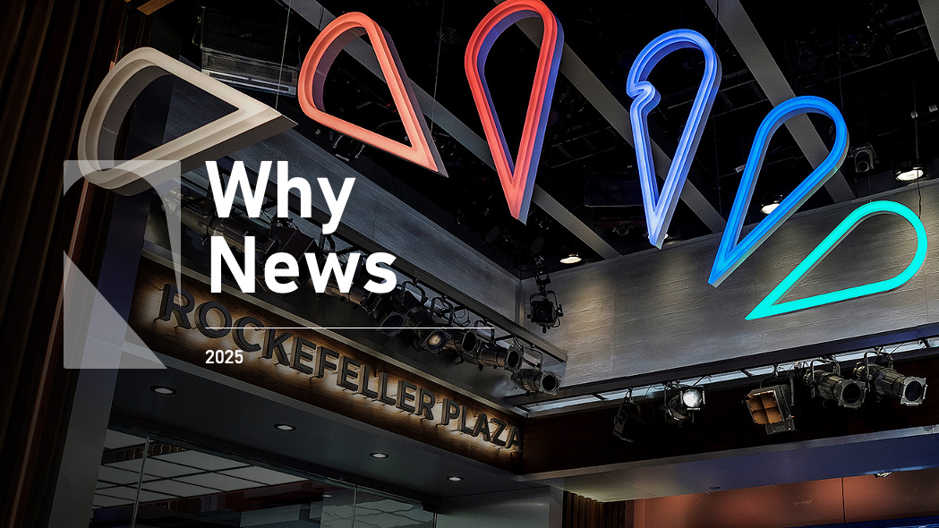

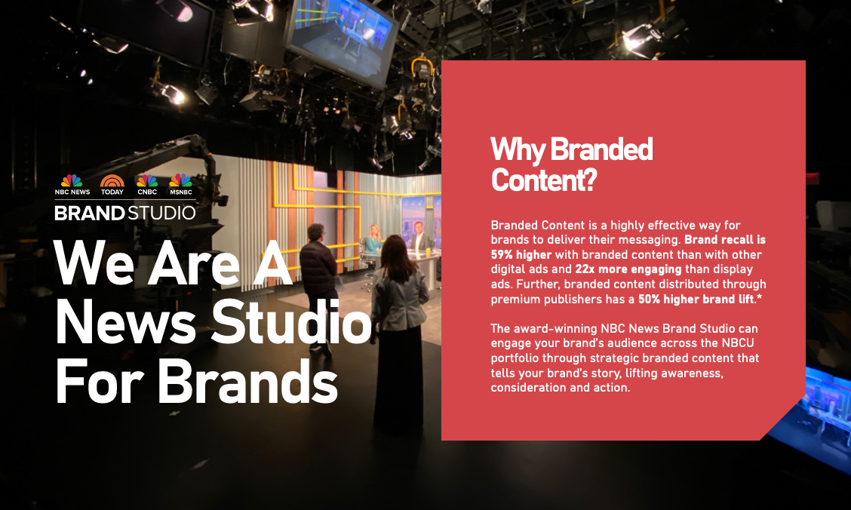
GTM Resources
Click for deck
25/26 GTM
Materials
Q2’25 Scatter to Capitalize on Current B2B Momentum
2025 Sports
Upfront Deck
News GTM
Materials
CNBC GTM
Materials
News Brand Studio
GTM Materials

Slide 50
Thank You
Category Strategy
Dominique Folacci & Nicole Lee
Sales Enablement
Jess Cohen
Trade Marketing
Carolyn Scaglione, Bonnie Fallon
50

